Slide 1
Resources for Community Gardeners & Farmers
Community Gardeners & Farmers Workshop

Slide 2

Presenter:
Ms. E’licia L. Chaverest,
Strategic Alignment Network, LLC and Rural South Institute
Madison, Alabama

Slide 3
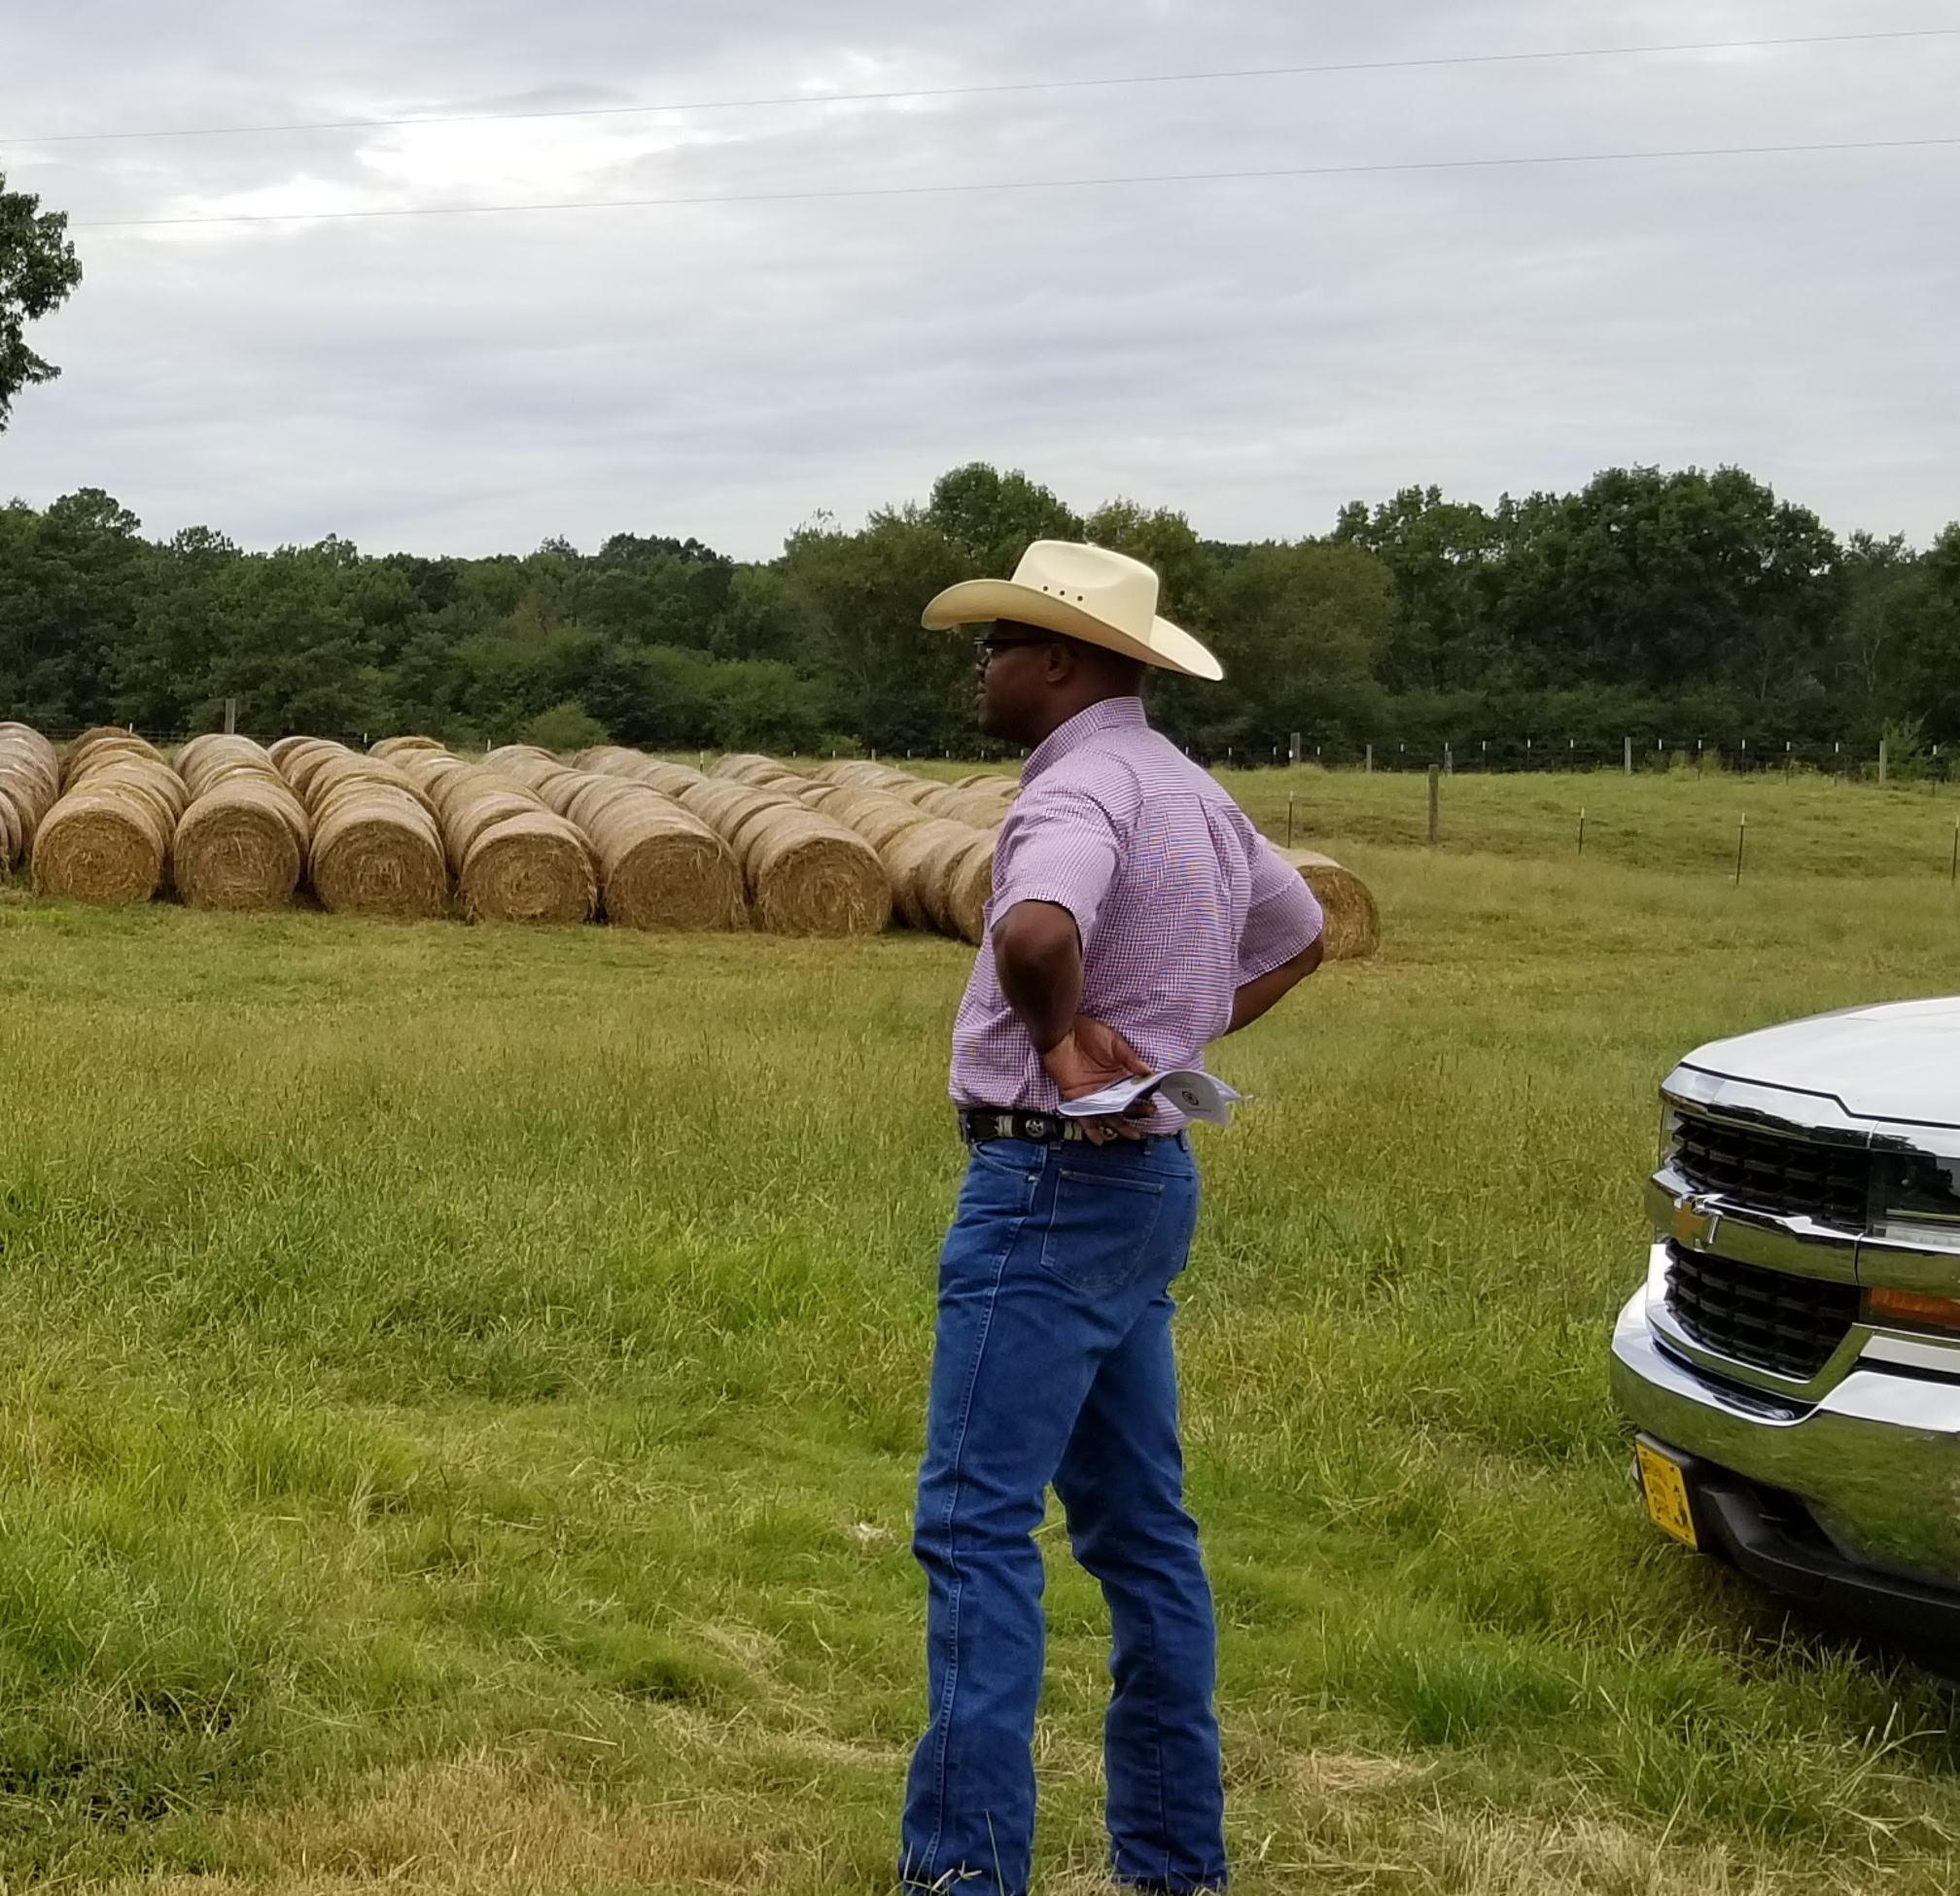
In This Presentation:
RESOURCES AVAILABLE
Funding Opportunities
Educational Program
Networks
THIS PROGRAM:
We’re building communities, building economy, and building capacity.

Slide 4
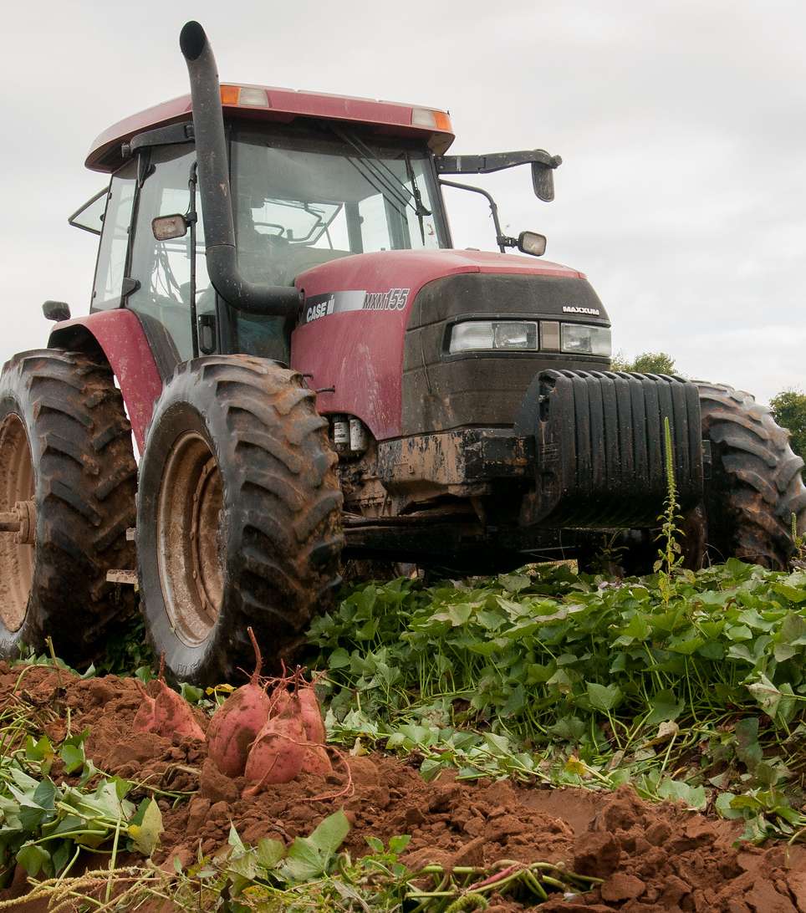
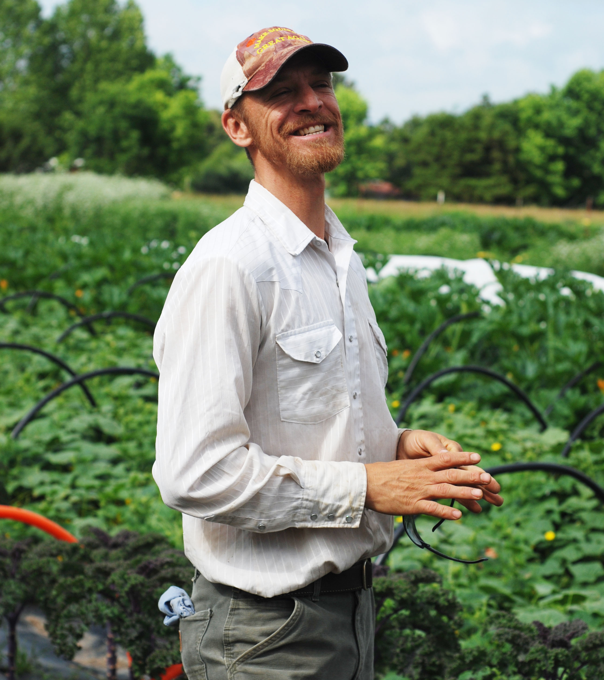
Rural South Institute (RSI)
Regional Program
Region Served: Alabama, Georgia, Tennessee & Mississippi
Rural South Institute: Agricultural Consultant Business Program which works to assist and empower farmers, gardeners, cooperatives, agribusiness throughout Alabama and southern region. The program is developed to assist entities in becoming more sustainable, marketable, aware to new and emerging issues, and USDA government programs and services in agriculture.
WEBSITE: https://www.ruralsouthinstitute.com/

Slide 5


Strategic Alignment Network, LLC
Regional Program
Strategic Alignment Network, LLC was established in 2019, in Madison, Alabama. Our mission is to educate and empower young professions for c-suite leadership positions. In addition, we provide individual and organizational training in grant writing, professional and leadership development, agricultural educational programs, and mentorship for young and seasonal professional. Our services extend from inspiring future leaders (motivational speaking engagement) to serving and working with the community (economic development).
Strategic Alignment Network, LLC has nearly 22 years of experience educating and empowering urban and rural farmers, women-in agriculture, community leaders and non-profit organizations throughout the state of Alabama, Georgia, Mississippi and Tennessee. We have inspired individuals from all demographics (rural and urban communities) to assist them to reach their full potential in business, including assistance in building strong partnership to the advancement of their community.
WEBSITE: https://www.strategicalignmentnetwork.com

Slide 6
Local Government
Southern Rural Development- Delta Direction Health and Economic Renewal
in the Mississippi Delta
Mississippi Department of Agriculture and Commerce Bureau of Plant Industry (BPI)
Small Business Administration
Mississippi Outdoor Stewardship Trust Fund (MOSTF)
Community Foundation for Mississippi
  John F. And Lucy Shackelford Fund Grants
  LGBTQ Fund of Mississippi
  Website: https://formississippi.org/grants

Slide 7
Institutions in Mississippi
AND SURROUNDING AREA
Alcorn State University’s and Mississippi State University Extension Program
Alcorn State University’s National Policy Center
University of Arkansas-https://www.uaex.uada.edu/
Tuskegee University
Alabama A&M University
Auburn University

Slide 8
UDSA Programs
USDA RURAL DEVELOPMENT:
Value-Added Producer’s Grant (VAPG)
Rural Community Development Initiative Grants in Mississippi.
FARMER’S MARKET PROMOTION PROGRAM (FMPP)
LOCAL FOOD PROMOTION
PROGRAM (LFP)
USDA Programs for producers, agribusiness and organizations to develop food systems infrastructure, value-added food products,
and markets.

Slide 9
Additional USDA Programs
FARM SERVICE AGENCY (FSA)
Youth Loan Programs
Microloans
Organic Certification Cost Share Programs
NATURAL RESOURCES CONSERVATION SERVICE (NRCS)
Works with farmers, landowners, institutions, gardeners and organizations with the following:
EQIP program, fencing, conservation practices, high-tunnel/hoop houses.
Website: https://www.nrcs.usda.gov/programs-initiatives

Slide 10
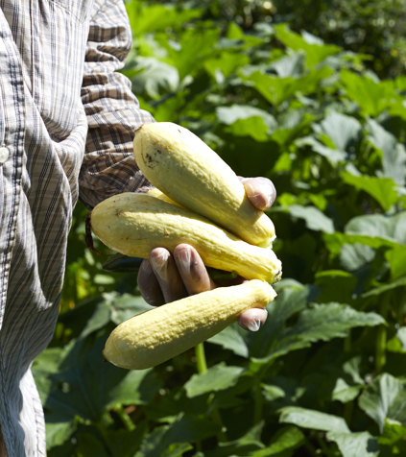

Federation of Southern Cooperatives & Alabama State Association of Cooperative
Locally led. Regionally coordinated. Cooperatively owned.
The Federation of Southern Cooperatives/Land Assistance Fund is a 57-year-old regional cooperative and rural economic development organization serving a membership of Black farmers, landowners, cooperatives, and other low-income rural people in the South with coop development, land retention, and advocacy.
Contact: Freddie Davis III, Director- RTRC
Darren Beachem Alabama State Coordinator
Website: https://www.federation.coop/
ALABAMA FIELD OFFICE
575 Federation Rd. Gainesville, AL 35464
Send Mail: PO Box 95, Epes, AL 35460.
(205) 652-9676 & (205) 652-9678

Slide 11
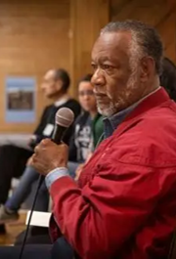

Mississippi Association of Cooperatives (MAC)
MAC provides support for cooperative businesses, family farmers, and rural area residents, enabling them to improve their lives and communities; and to maintain and support training and educational programs that will enhance the quality of life for rural residents.
MAC is the parent organization of the Mississippi Center for Cooperative Development. Member organizations include cooperatives, two credit unions, and two associated organizations. Our cooperatives are located across the state. Popular crops include watermelon, southern peas, okra, leafy greens, and sweet potatoes. Member organizations market their goods through multiple avenues: direct sales, farmers' markets, grocery stores, and food distributors or service providers.
Website: mississippiassociation.org
FIELD OFFICE
Mississippi Association of Cooperatives
233 E Hamilton St, Jackson, MS 39202
(601) 944-0592

Slide 12

National and Regional Resources
National Center for Appropriate Technology
  National organization with regional programs on agricultural topics
Sustainable Agriculture Research & Education (SARE)
  Regional grants on various topics, publications, and great connection
American Community Garden Association
  Regional programs and resources are available throughout the US
RAFI
  Funding opportunities and grants available

Slide 13
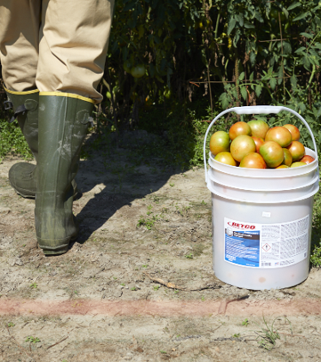
BONUS: Resources in Neighboring States
Resource Conservation & Development Council (RC&D)
A local grant program which stems from a nonprofit organization that connects South Alabama communities to the resources and partnerships needed to drive economic development in an environmentally sustainable way. Website: https://ala-tomrcd.org/about-rcd/
Alabama Department of Agricultural and Industries.
Cost share programs available
Alabama Farm Credit
Provide loans to farms but grants. JumpStart Grants for $10,000.
Texas Local Food Center
Educational courses online. https://texaslocalfood.org/
Alabama Cooperative Extension System. Educational courses online. https://aces.catalog.auburn.edu/

Slide 14
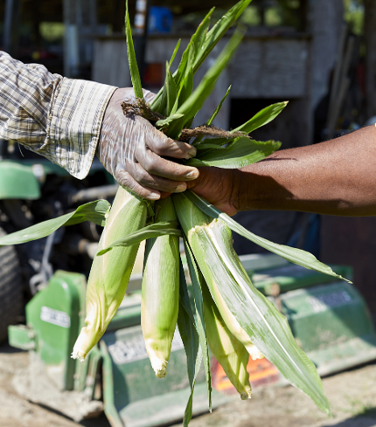
Crop Insurance
Crop Insurance Navigator Program
Did you know you can get crop insurance as a community farm or small farmer?
The Crop Insurance Navigator Program works to enhance the understanding and use of federal crop insurance by producers historically underserved by crop insurance sector.
RMA Programs
National Crop Insurance Service
Contact your Local Specialist: 1-888-731-0888
Mr. Lagrand Elliot, Navigator Project Specialist
lelliott@uada.edu

Slide 15
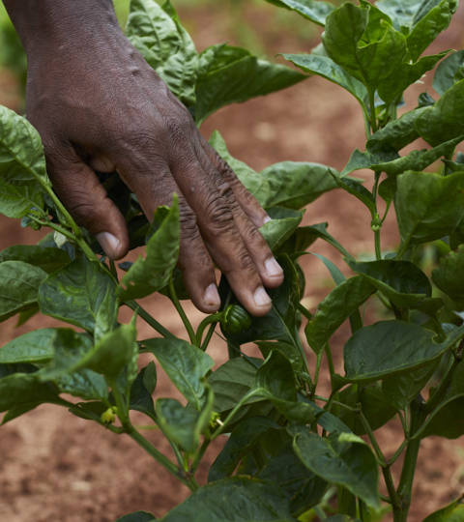
Minimizing Agricultural Risk
Risk Management Strategies
Crop Insurance
Crop Diversification
Crop Rotation and Production
Contracts
Off-Farm Employment
Agri-Tourism
Niche Market (U-pick, Farmer’s Market, Community Supported Agriculture-CSA)
Resource: USDA Economic Research Service and Agricultural Marketing Service and Southern Risk Management Education Center.

Slide 16
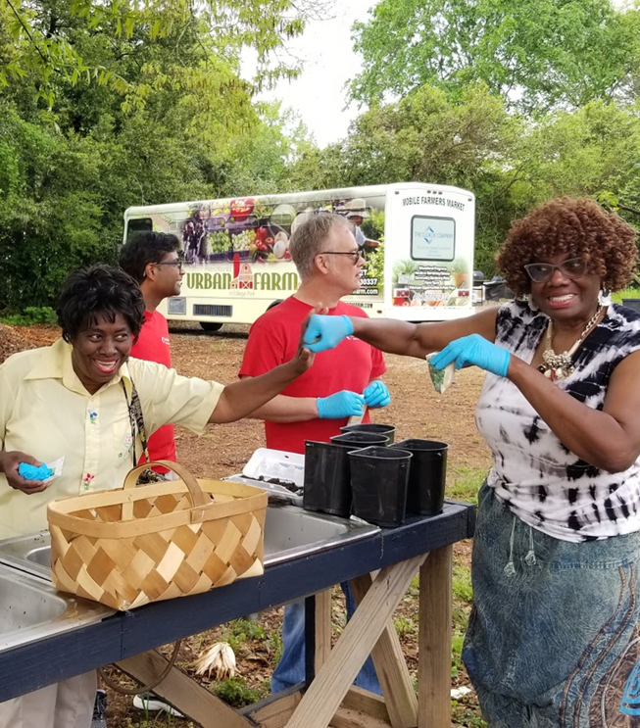
Takeaways
Develop a game plan
Assemble a team
Start where you are, start now
Document each step
Develop a Risk Management Plan (FSMA PSA course, Crop Insurance, & Diversification)
Know where to find help when needed
Don’t be afraid to ask questions
Look for partners and funding opportunities
Give yourself grace

Slide 17


Learn more about Strategic Alignment, LLC.
FACEBOOK
Strategic Alignment Network, LLC
INSTAGRAM
@STRATEGIC205
WEBSITE
Strategicalignmentnetwork.com
CONTACT US
E’LICIA (LISA) CHAVEREST
Contact number: 256-457-8564
echaverest@gmail.com or
info@strategicalignmentnetwork.com

