Slide 1
Crops Suitable for your Small Farms and Gardens
Bill Evans, WBE Ag and Environmental Training Center

Slide 2
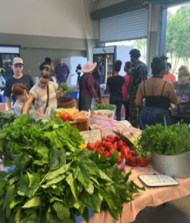
Considerations
Season
Space
Previous Crops
Seed or Transplant
Plant Family
Difficulty and Experience
Markets if Selling
Likes/Dislikes

Slide 3
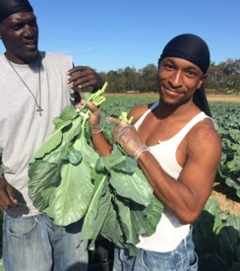
Beginner Crops
  Turnip
  Mustard
  Collard
  Kale
  Lettuce
  Beans and Peas
  Okra
  Hot Peppers
  Blueberries

Slide 4
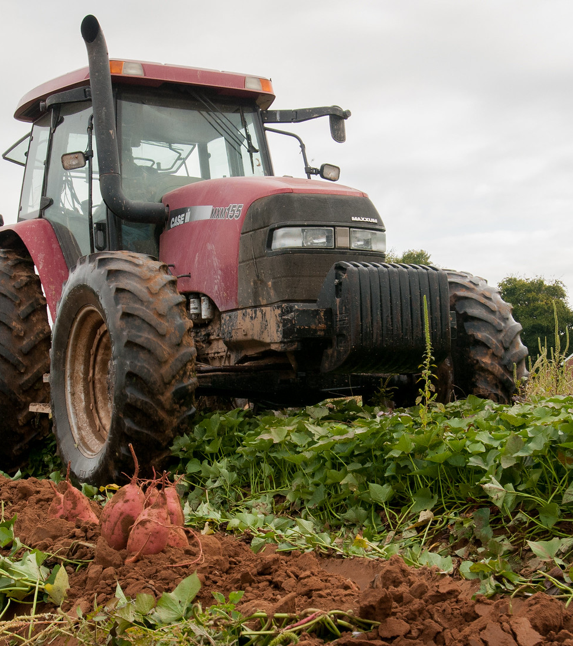
Intermediate Crops
  Bell Peppers
  Tomatoes
  Broccoli
  Cabbage
  Asian Greens
  Squash
  Watermelon
  Potatoes and Sweet Potatoes
  Onions and Leeks

Slide 5
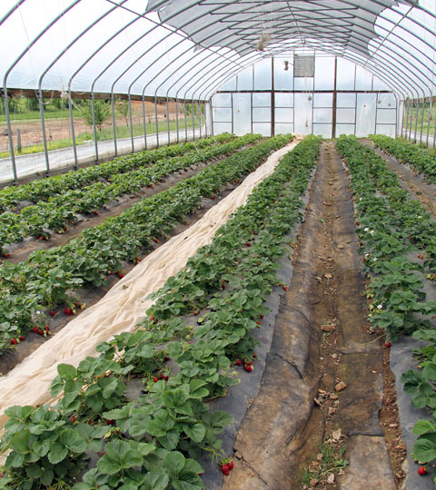
Advanced Crops
  Spinach
  Cauliflower
  Brussels Sprouts
  Pumpkin
  Sweet Corn
  Strawberries

Slide 6
Questions?
Contact Bill Evans, Ph.D.,
growtoknownow@gmail.com
Cell: (601)-668-8997

