Slide 1
Fresh Fruits, Vegetables, Herbs, and Physical Activity
Astria Goolsby, Owner of Verve Health Station

Slide 2




Astria Goolsby, Owner of
Verve Health Station
Bachelor of Science in Exercise Science
NCCA accredited Professional Trainer
Health and Nutrition Coach
Diabetes Prevention Lifestyle Coach

Slide 3
Processed Foods

Slide 4
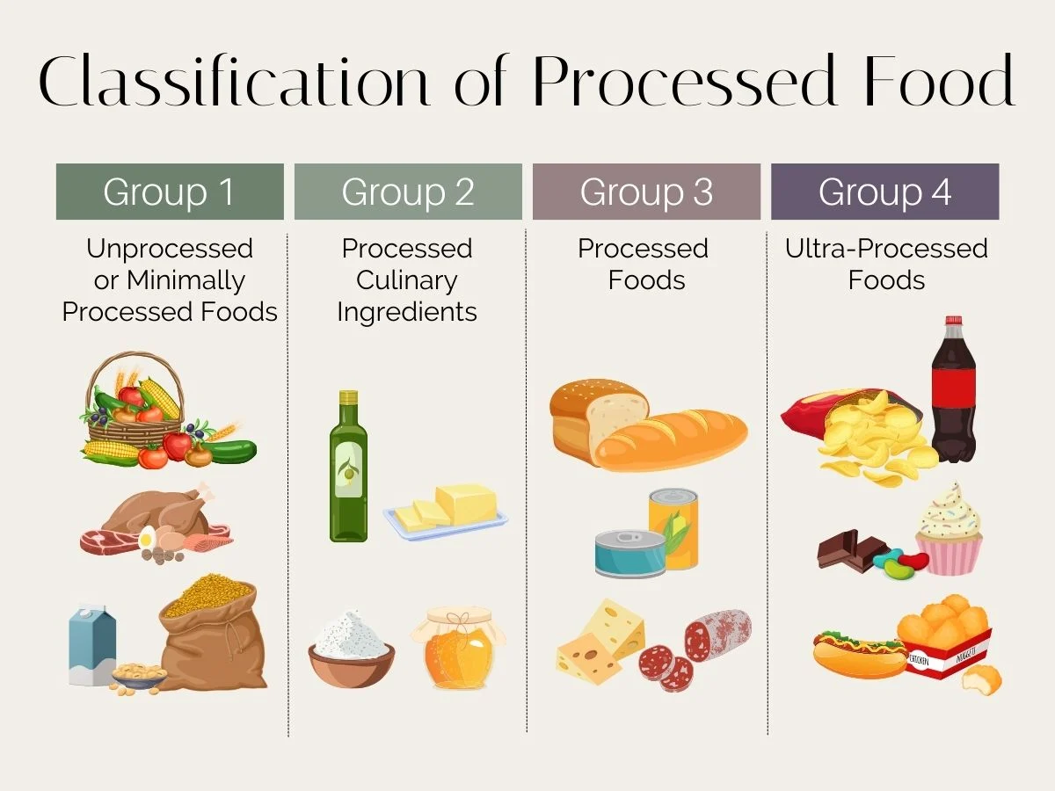
Processed Foods
Foods that have changed from their natural state.
United States Department of Agricultural (USDA) Definition:
Any raw agricultural commodity that has been subject
to various procedures that alter the food from its
natural state.

Slide 5
Group 3 and 4
Group 3: Processed Foods
These foods involve combining unprocessed or minimally processed foods with culinary ingredients.
Examples include:
Canned vegetables
Fruits in syrup
Salted nuts
Cheese
Freshly made bread
Group 4: Ultra Processed foods
These are industrially formulated food products with many added ingredients, including additives like preservatives, flavorings, and colorings.
Examples include:
  Carbonated drinks
  Packaged snacks/foods
  Boxed foods
  Frozen meals
  Sweets

Slide 6
Group 1 and 2
Group 1 – Unprocessed or Minimally Processed
These are foods in their natural state, or with minor changes like washing, cleaning, or freezing.
Examples include:
  Fresh fruits and vegetables
  Whole grains
  Eggs
  Meat that hasn't been altered beyond basic preparation
Group 2 – Processed Culinary Ingredients
These are ingredients derived from whole foods through processing and are used in cooking rather than eaten on their own.
Examples include:
  Oil
  Butter
  Sugar
  Salt

Slide 7
Reading Nutrition Labels for your Health

Slide 8
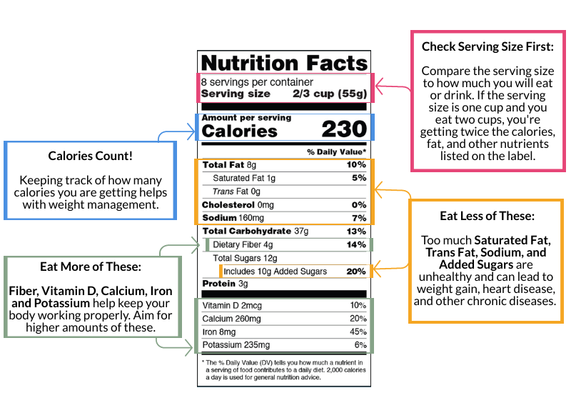
Reading Nutrition Labels

Slide 9
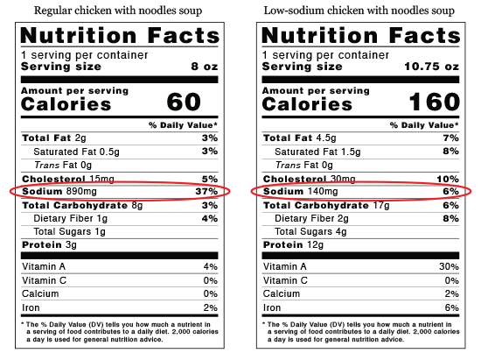
for Blood Pressure
Reading Nutrition Labels

Slide 10
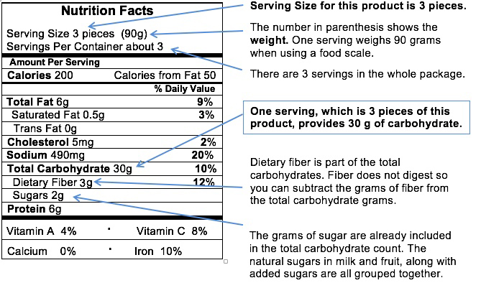
for Glucose Control
Reading Nutrition Labels

Slide 11
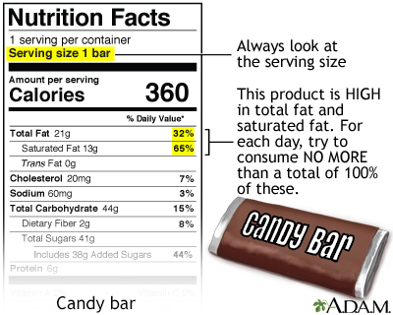
for Good Cholesterol
Reading Nutrition Labels

Slide 12
Benefits of Fresh Fruits and Vegetables

Slide 13
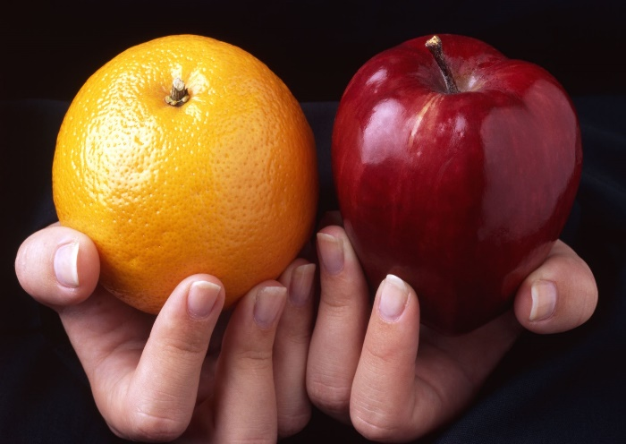
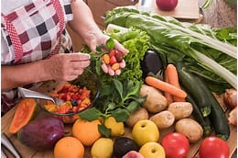
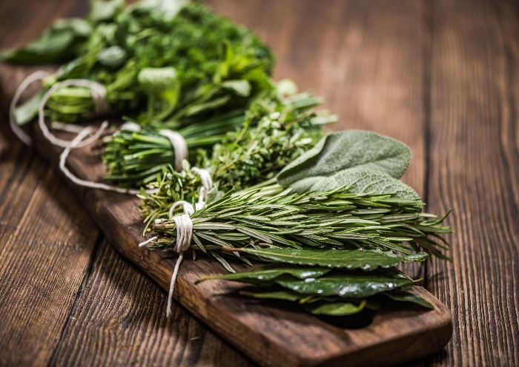
Benefits of Fresh Fruits and Vegetables
Fruit:
Vitamins and Minerals, Antioxidants, Fiber, Heart Health, Cancer Prevention, Weight Management, Diabetes Management, Improved Digestion, Mood Boost, Hydration
Vegetables:
Enhanced Immunity, Weight Management, Reduced Disease Risk, Eye Health, Heart Health
Herbs:
Anti-inflammatory, Antimicrobial Properties, Anti-cancer Effects
Stroke
Heart Attack
Cardiovascular Disease
Lower Blood Pressure
Prevent Cancer
Eye Issues
Digestive Issues
Decrease Inflammation
Mental Health
Joint Pain
Motion Sickness
Anxiety
Stress
Sleep Quality
Stomach Issues
Memory

Slide 14
Pysical Activity vs.
Exercise
Physical activity is movement that is carried out by the skeletal muscles that requires energy. In other words, any movement one does is actually physical activity.
Exercise, however, is planned, structured, repetitive, and intentional movement intended to improve or maintain physical fitness.
Exercise is a subcategory of physical activity.

Slide 15
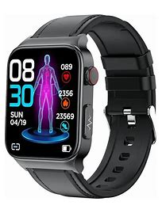
Exercise Heart Rate
Weight Loss Heart Rate Zone is 60%-70% of your maximum (max) heart rate
Max Heart Rate is 220 minus your age
Beats per Minute = (bpm)
Example
Astria’s Age = 42
Astria’s Max Heart Rate is 220 - 42 = 178
Astria’s Max Heart Rate times 60% is 178 x .6 = 106 bpm
Astria’s Max Heart Rate times 70% is 178 x .7 = 124 bpm
Astria’s heart rate zone for weight loss is between 106 to 124 bpm

Slide 16
Making an Action Plan for Lifestyle Change

Slide 17

Making a Lifestyle Change and Action Planning
WHAT IS LIFESTYLE CHANGE?
Lifestyle changes are a process that take time and require support
Action Plan
Goal - Small Changes
What – Something YOU want to do
How Much – Time, distance, amount, etc.
When – Time of day or day of the week
How Often – Number of days out of the week
Confidence Level – From 0-10

Slide 18

Contact Us!
Astria Goolsby
Website: https://vervehealthstation.com
Email: astria@vervehealthstation.com
Phone: (601)308-4220

